Slide 1
Infertility for the Family Doctor
CME on the Run! 2018 – Prenatal, Pediatric & Adolescents
Ken Seethram, MD, FRCSC
Co-director, Pacific Centre for Reproductive Medicine, BC & Alberta
Associate Clinical Professor
UBC Division of Reproductive Endocrinology and Infertility
UA Division of Reproductive Endocrinology and Infertility

Slide 2
disclosure
I do not currently participate in any research trials with pharmaceutical companies involved with fertility care
I do not receive any research grants or stipends from such companies
I am current a principal investigator with a microbiome endometrial assay from Igenomix but receive no payment or reimbursement for clinical activities

Slide 3
objectives
To provide guidance for the timing of fertility investigation and workup in healthy male and female adults.
To highlight cases that may need early referrals or specialist workup.
To review ways to manage common fertility questions in the office.

Slide 4
outline
Fertility statistics
When to start testing
How to test
Why to test
Common office questions

Slide 5
When to start testing?
Diagnostic evaluation should start after 12 months of regular unprotected intercourse in women under age 35
85% of couples will achieve pregnancy in that time frame
95% of couples will achieve pregnancy in the year following
So if a couple has been trying for a year without success, start testing

Slide 6
When to start testing?
Should you test sooner in some people?
  History of oligomenorrhea/amenorrhea
  Suspected pelvic disease (prior STI, endometriosis etc)
  Known/suspect male factor
  Women planning to use donor semen or freeze their eggs
  Women over age 35 – start after 6 months

Slide 7
What is the diagnostic evaluation?
It’s e-a-s-y
  Eggs
  Anatomy
  Sperm
  YES - most patients you see will eventually become pregnant

Slide 8
Eggs. EASY
You need eggs to get pregnant - your eggs or someone else’s
Most often, the menstrual history will uncover problems with regular ovulation and hence cycle regularity
  This can be enhanced with basal body temperature charting, LH kits to detect the LH surge, and moliminal symptoms
  If they’ve done BBT charting and it shows a temperature spike, they don’t have to keep charting
If they have irregular cycles, then they need a referral for diagnostic evaluation, and ovulation induction if indicated

Slide 9
Eggs. EASY
So regular cycles usually means a person has eggs
How do you test eggs? – we worry about quantity and quality
  The best test is to take an egg out, looks at it, and try to fertilize it – impractical – but the only quality test
  Quantity? We rely on substitute markers for eggs – this is known as ovarian reserve testing
        Age
        Prior conception
        Tests

Slide 10
Eggs. EASY
Testing provides prognostic information for women at risk for diminished ovarian reserve
  over 35
  family history of early menopause
  single ovary or prior ovarian surgery/chemo/rads
  unexplained infertility
  planning assisted reproduction
Which is essentially everyone we see – hence doing the following tests is a good starting point

Slide 11
Eggs. EASY
There are three primary lab tests we use to screen for a drop in ovarian reserve
  Day 3 FSH & estradiol
  Anti-Müllerian Hormone (AMH)*
  Ultrasound (Antral follicle counts, AFC)* - done in Fertility Clinics
    *these are considered to be the two best out of the three

Slide 12
Eggs. EASY
Day 3 FSH & estradiol
  The estradiol is merely to ensure you’re getting a follicular phase FSH determination and should be under 200 pmol/L
  FSH should be done day 2/3 (depending on lab hours) and should not exceed 10-20 IU/L – with high values being linked to poor response to treatment
  But it is not a sensitive indicator of who will respond poorly – therefore good as a screening tool only

Slide 13
Eggs. EASY
Anti-Müllerian Hormone (AMH)*
  AMH is made by granulosa cells of developing follicles and are FSH/LH independent
  stays consistent cycle to cycle
  Can be obtained on any day of the cycle
  High (2-3X) in PCOS
  When low will predict poor response to ovarian stimulation, poor embryo quality, and poor IVF outcomes

Slide 14
Eggs. EASY
Ultrasound (Antral follicle counts, AFC)*
  Sum of antral follicles in both ovaries via transvaginal ultrasound in the follicular phase
  3-6 total is considered ‘low’ and linked with poor response during IVF
  Increased in PCOS
  Decreased by OCP use

Slide 15
Summary - Eggs. EASY
Obtain a menstrual history
Get:
  FSH
  Estradiol
  AMH (for cases where you suspect drop in egg reserve)
  and if abnormal, refer to specialist for further diagnostics like AFC, and treatment
What about other hormones?
  TSH – only for ensuring euthyroid status (target 2.5-3.0 ng/ml)
  Prolactin – only for oligo-ovulatory or anovulatory cases
  Fancy other stuff you see ordered? (ex. DHEA, 17-hydroxyprogesterone etc) may assist with the diagnosis of PCOS, but won’t really help in the early stages – let the fertility clinic organize it if required

Slide 16
Anatomy. EASY
We need a normal uterine cavity, myometrium, Fallopian tubes, and ovaries
The appearance of the ovaries and pelvic space is only needed if the patient has symptoms of a GYN issue or prior issues
If not, we check out the uterus and tubes via:
    HSG
    Laparoscopy with hydrotubation - if the clinical situation suggests this is required

Slide 17

Anatomy. EASY
HSG is the most practical
What to do if HSG abnormal?
  The patient should be placed on antibiotics for 3 days (doxycycline 100mg PO BID x 3d)
Referral for fertility consultation
  If one tube blocked, ultrasound follicle tracking can help with timing of intercourse or insemination
  Both tubes blocked? Only IVF

Slide 18
Sperm. EASY
Sperm is the easiest thing to check.
Except for the prehistoric man who believes it’s not a man’s problem.
Concentration, motility, progressive forms, morphology all have importance, but the biggest predictors are concentration and motility
Abstain from an ejaculate 2-5d prior to testing

Slide 19
Sperm. EASY
Test after 12 months of trying (just like for women)
Or test after 6 months in couples where the female partner is over 35
Screen for:
  Systemic disease like diabetes
  Exposure to gonadotoxins/heat

Slide 20
Sperm. EASY
Interpreting the semen analysis
  We know when men are fertile
    Concentration >48M/mL, motility over 63%, and morphology over 12%
  We know when they are subfertile
    Concentration <13.5M/mL, motility <32%, morphology <9%
  In between we don’t really know
  So men having values within the reference range may still be infertile
Lower acceptable limits:
  Concentration 15M/mL
  Motility <40%
  Morphology <4%

Slide 21
Sperm. EASY
What to do when abnormal?
  Referral to a fertility centre
  If concentration under 10M/mL, with impaired sexual function, consider FSH AND Testosterone determinations
More advanced testing?
  Leave it up to the fertility clinic
  Can include ultrasound, screening for CF, karyotyping, microdeletion screening, more advanced endocrine screening

Slide 22
Sperm. EASY
What about morphology
  The appearance of sperm
  Sometimes reports will show high numbers of abnormal sperm, or immature forms
  If the concentration and motility are normal, don’t panic
  Note the time to process – often the recommended times are exceeded
  Morphologic abnormalities may require ICSI for correction during IVF

Slide 23
EAS.Y – what about the Y?
Even in unexplained infertility, in a large cohort trial (Brandes et al, 2010, Human Reproduction)
  2476 patients, with or without treatment
  98.6% were pregnant within three years of first visit
  And most (75%) were conceived spontaneously
So Yes, eventually most couples will conceive
Enemy – time
  We also see a lot of couples planning on having 2-3 children but presenting at age 35
  In their case, IVF for cryopreservation of embryos is ideal to allow future family expansion

Slide 24
Common fertility office questions
Timing of intercourse?
  Two approaches in the regularly menstruating patient
    Intercourse every other day, Cycle day 10-20
    Use of ovulation predictor kits (OPK) which assess the LH spike
  Which OPK kit to use?
    They all work the same way
What about hot tubs
  Prolonged heat exposure not advised
  Prolonged saddle time for road bikers – heat

Slide 25
Common fertility office questions
Should I keep charting temperature?
  Only if the patient desires insanity
Should I be taking progesterone in the luteal phase
  Common naturopath intervention based on salivary hormone levels
  Quick answer: in the absence of recurrent early loss, and short luteal phase: NO
I can wait as long as I want to get pregnant, right?
  No, the mediagenic advanced maternal age is a myth – generally celebrities getting pregnant after age 45 are doing it via donor egg

Slide 26
Common fertility office questions
What about stress – should I just relax
  No. Stress doesn’t impact fecundity – time does
I haven’t met a life partner, or I’m not sure I want a partner - should I freeze my eggs
  Increasing trend in social oocyte freezing
I’ve heard IVF costs about $50,000
  No. IVF in Canada, with medications runs about 12,000-14,000 dollars

Slide 27
The EASY executive Summary (1)
Start testing after 12 months of unprotected intercourse without conception
  Eggs
    Day 3 FSH, Estradiol, TSH
    AMH (not considered a ‘routine’ test, but can be very helpful in treatment planning and timing)
  Anatomy
    HSG (antibiotics only if tubes blocked at time of HSG)
  Sperm
    Semen analysis
  Yes
    There’s a high likelihood that eventually you will become pregnant

Slide 28
The EASY executive Summary (2)
History and physical
Evaluate the male partner
Over 35, start after 6 months
Start earlier if
  abnormal cycles
  Endometriosis
  other conditions
Refer immediately for
  Single/same-sex relationships
  Prior gonadotoxic treatments
  Advanced age
  Social Oocyte freezing
  Prior vasectomy

Slide 29
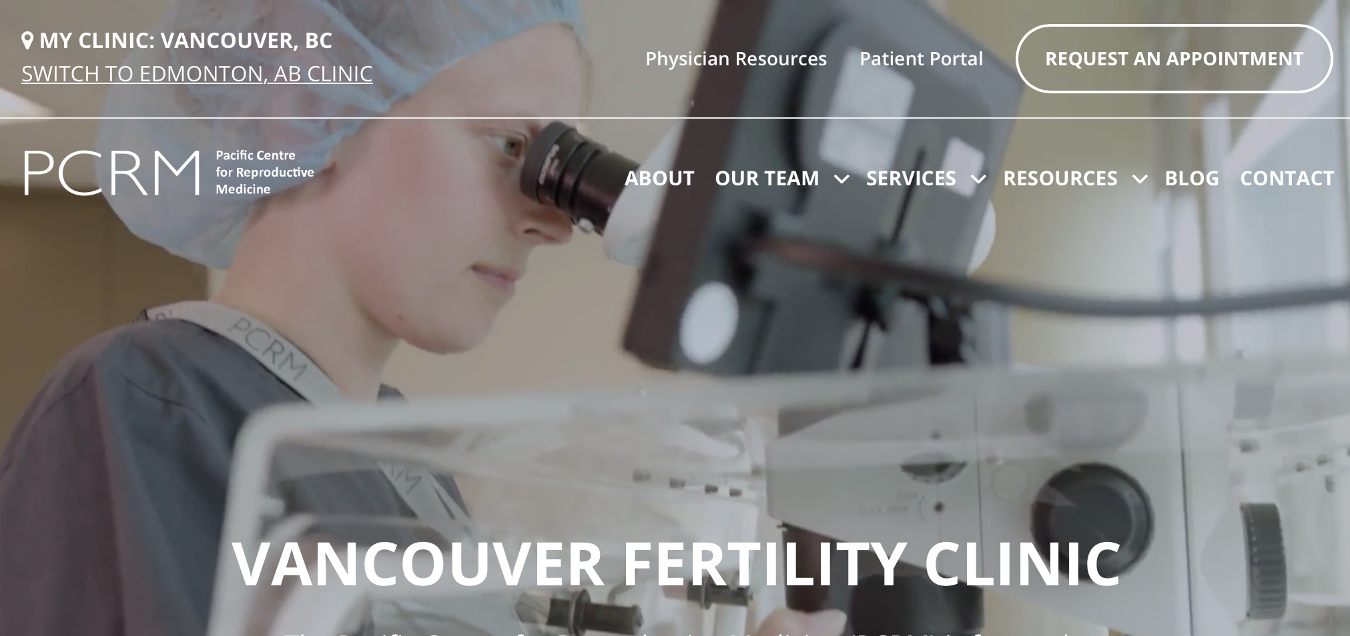
Copy of talk: Pacificfertility.ca
Should I be taking progesterone in the luteal phase
Should I be taking progesterone in the luteal phase

